Slide 1
Romania – Republic of Serbia IPA Cross-border Cooperation Programme
Programming Languages
Lecturer: lect. dr. eng. Razvan BOGDAN
Notes:
Slide 1: Hello everyone and welcome to programming languages course.

Slide 2
Programming Languages
Lecture 7
Lists, Dictionaries and Tuples
Notes:
Slide 2: In this lecture we are going to talk about Lists, Dictionaries and Tuples.

Slide 3
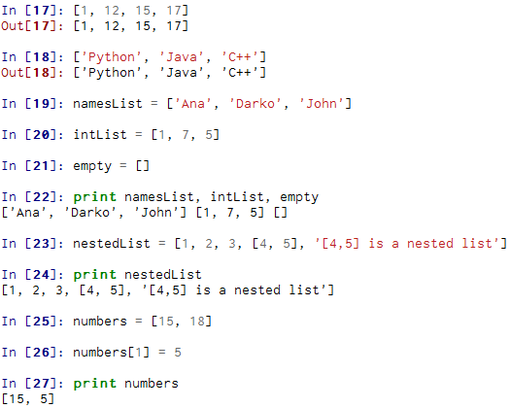
A list is a sequence
Like a string, a list is a sequence of values
Values can be of any type; they are called elements or items
Notes:
Slide 3: A list is a sequence:
Like a string, a list is a sequence of values. The values can be of any type, being called elements or items. Sometimes a list is referred to as a collection because a collection allows us to put many values in a single “variable”. There are several ways to create a new list; the simplest is to enclose the elements in square brackets ([ and ]). In our first example, we create a list of four integers, but we can also create a list of strings, as we can see on the example starting on line [18]. We can create an empty list as we see on line 21 or even a list in another list (called nested list) as is the list containing the integers 4 and 5 on line 23.
Unlike strings, lists are mutable because you can change the order of items in a list or reassign an item in a list. You can see how on the numbers list, the 18 element was changed with 5. You can think of a list as a relationship between indices and elements. This relationship is called a mapping; each index “maps to” one of the elements.
List indices work the same way as string indices:
• Any integer expression can be used as an index.
• If you try to read or write an element that does not exist, you get an IndexError.
• If an index has a negative value, it counts backward from the end of the list. (Charles Severance, Python for Informatics: Exploring Information)

Slide 4
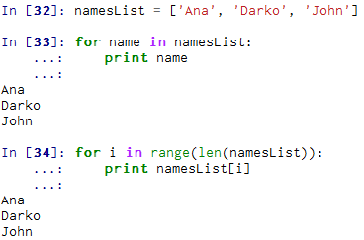
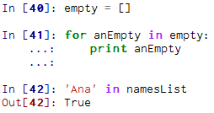
Traversing a list
The most common way to traverse the elements of a list is with a for loop
range returns a list of indices from 0 to n−1, where n is the length of the list.
Notes:
Slide 4: Traversing a list:
The most common way to traverse the elements of a list is with a for loop. For example we have out namesList; so we will iterate through the list’s elements using an iteration variable and a for loop. The same result can be obtained by using range because it returns a list of indices from 0 to n−1, where n is the length of the list. Each time through the loop i will get the index of the next element, so in the print we will display the value associated with index i.
If we want to print the elements of an empty list, the body of the for will never be executed, so in our example, nothing will be displayed. If we want to check if a certain element is part of a list we can use the in operator as we can see o line 42. Pay attention that if the element you want to search is a string that the quotes should be used,

Slide 5
Concatenating lists using +
>>> a = [1, 2, 3]
>>> b = [4, 5, 6]
>>> c = a + b
>>> print c
[1, 2, 3, 4, 5, 6]
>>> print a
[1, 2, 3]
We can create a new list by adding two existing lists together
Notes:
Slide 5: Concatenating lists using +:
In order to create a new list by adding two existing lists together, we use the concatenate operator for list, namely plus. In our example we can probe that we concatenate list a and list b and obtain list c which includes the elements of both initial lists.

Slide 6
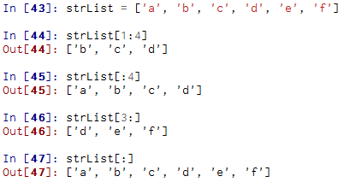
Lists can be sliced using :
Remember: Just like in strings, the second number is "up to but not including"
Notes:
Slide 6: Lists can be sliced using : :
The slice operator also works on lists. So, if you omit the first index, the slice starts at the beginning. If you omit the second, the slice goes to the end. If we omit both, the slice is a copy of the whole list, just as we can note on line [47].

Slide 7
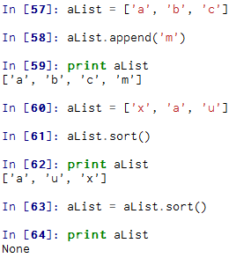
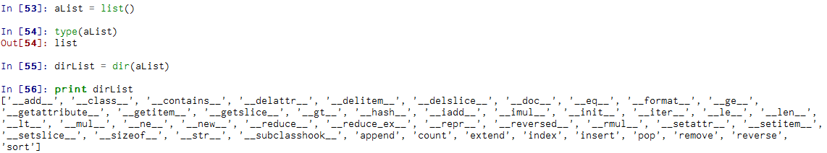
List Methods
Examples:
append adds a new element to the end of a list
sort arranges the elements of the list from low to high
http://docs.python.org/tutorial/datastructures.html
Notes:
Slide 7: List Methods:
Python provides methods that operate on lists. In order to see all the methods for lists, we create a list with all these methods, as you can see on lines 53 to 56. Now, I encourage you to go on the official python documentation, read about all these methods and try using them in different examples. Here we will use append and sort. Append adds a new element to the end of a list, while sort arranges the elements of the list from low to high. It is interesting to note that most list methods are void; they modify the list and return None. But if you try to write something like you see on line 63, namely in a list variable you want to put the result of the same variable where you call sort(), then the obtained result will be None, which means that the initial list has been emptied.

Slide 8
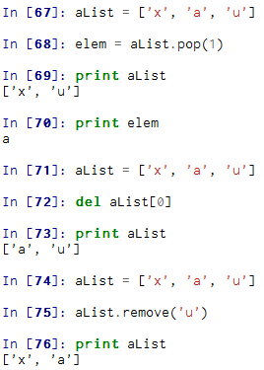
Deleting elements
Examples:
pop modifies the list and returns the element that was removed
If you don’t need the removed value, you can use the del operator
If you know the element you want to remove (but not the index), you can use remove
Notes:
Slide 8: Deleting elements:
We can delete elements from a list in different ways. If we know the index of the element you want, we can use pop. This will modify the list, but also will return the deleted element, as you can see in the example. If we don’t need the removed value, we can use the del operator and if we know the element we want to remove (but not the index), we can use remove.

Slide 9
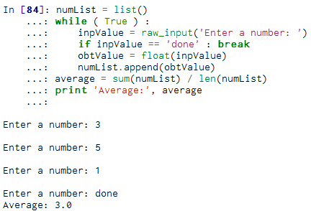
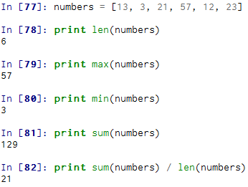
Lists and functions
There are a number of functions built into Python that take lists as parameters
Notes:
Slide 9: Lists and functions:
There are several built-in functions that can be used on lists in a very convenient way. Here are some examples, like sum() which can be used only if the list’s elements are numbers. The other functions (max(), len(), etc.) work with lists of strings and other types that can be comparable. Starting on line [84] we write a small program that computes the average of a list of numbers which are entered by the user. We will make use of the built-in functions for lists. So basically, we start by making an empty list before the loop starts, and then each time we have a number, we append it to the list. At the end of the program, we compute the sum of the numbers in the list and divide it by the count of the numbers in the list just to obtain the average.

Slide 10
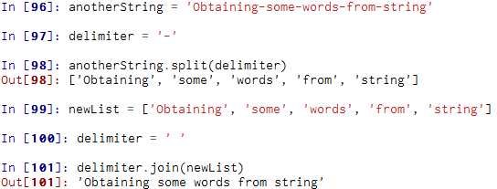
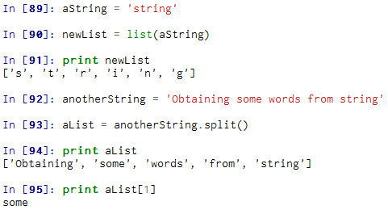
Lists and Strings
Split breaks a string into parts produces a list of strings. We think of these as words. We can access a particular word or loop through all the words.
Notes:
Slide 10: Lists and strings:
A string is a sequence of characters and a list is a sequence of values, but you should know that a list of characters is not the same as a string. So, to convert from a string to a list of characters, we can use list, as you see on the example from the slide, starting with line [89]. The list function breaks a string into individual letters. Now, if we want to break a string into words, we can use the split method, as you can see on lines 92 through 95. You can also call split with an optional argument called a delimiter. This delimiter specifies which characters to use as word boundaries. In the example from lines 96 through 99 you can see how a hyphen is used as a delimiter.
The reverse of list is join. This function takes a list of strings and concatenates the elements. Giving the fact that join is a string method, we have to invoke it on the delimiter and later on, pass the list as a parameter. Please see the example from lines 99 through 101 in this regard.

Slide 11
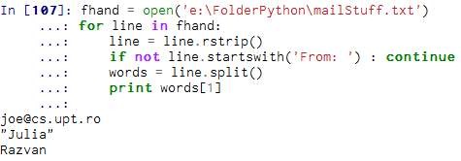
Parsing lines
parse the line to find some interesting part of it
Notes:
Slide 11: Parsing lines:
Usually when we are reading a file we want to do something to the lines other than just printing the whole line. Most of the time after reading a line we want to extract some important information out of it. So, first of all, a line parsing would be required for that. In the presented example, we search after the lines starting with “From:” and after that we print the sender of that email. For this we are splitting each lines in a list of Strings and from that we take the information we are interested in.

Slide 12
Dictionaries (1)
Dictionaries are Python’s most powerful data collection
Dictionaries allow us to do fast database-like operations in Python
Dictionaries have different names in different languages
Associative Arrays - Perl / Php
Properties or Map or HashMap - Java
Property Bag - C# / .Net
A mapping between a set of indices (which are called keys) and a set of values.
Each key maps to a value.
The association of a key and a value is called a key-value pair or sometimes an item.
Notes:
Slide 12: Dictionaries (1):
OK, dictionaries. Dictionaries are Python’s most powerful data collection; compared to a list where the indices have to be integers, in a dictionary the indices can be (almost) any type. Dictionaries have different names in different languages, like Associative Arrays in Perl / Php, Properties or Map or HashMap in Java, Property Bag in C# / .Net.
You can think of a dictionary as a mapping between a set of indices (which are called keys) and a set of values. Each key maps to a value. The association of a key and a value is called a key-value pair or sometimes an item. (Charles Severance, Python for Informatics: Exploring Information)

Slide 13
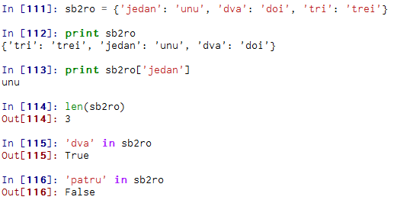


Dictionaries (2)
Notes:
Slide 13: Dictionaries (3):
As an example, we’ll build a dictionary that maps from Serbian to Spanish words, so the keys and the values are all strings. On the first line of our example we have created the dictionary. Please note that the dictionary is represented by the squiggly-brackets, {}. Also, to add elements to the dictionary we can use the square brackets. The order of the key-value pairs is not the same. Actually, if you type the same example on your own computer, you might get a different result. In general, the order of items in a dictionary is unpredictable. (Charles Severance, Python for Informatics: Exploring Information)
But that’s not a problem because the elements of a dictionary are never indexed with integer indices as we have seen when working with lists. Instead, you use the keys to look up the corresponding values.
You can see that the len function works on dictionaries; it returns the number of key-value pairs, after also the in operator can be use to search after a KEY in the dictionary and not value. What is useful in this regard is to use the method values(), which returns the values as a list, and then use the in operator, just as you can see on line 119 and 120.

Slide 14
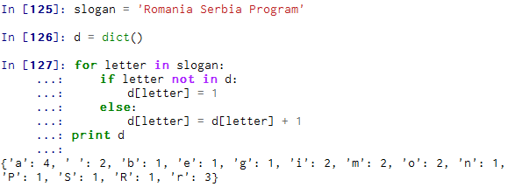
Dictionary as a set of counters (1)
Computing a histogram - a set of counters (or frequencies)
An implementation is a way of performing a computation
Notes:
Slide 14: Dictionary as a set of counters (1):
Suppose you are given a string and you want to count how many times each letter appears. So we are computing a histogram, which is a statistical term for a set of counters or frequencies. You could create a dictionary with characters as keys and counters as the corresponding values. The first time you see a character, you would add
an item to the dictionary. After that you would increment the value of an existing item. We call such an approach as being an implementation, namely a way of performing a computation. An advantage of the dictionary implementation is that we don’t have to know ahead of time which letters appear in the string and we only have to make room for the letters that do appear. (after Charles Severance, Python for Informatics: Exploring Information)
The Python implementation for constructing a histogram from a given string can be seen on the slide. Please note how we build the key-value pair each time we encounter a character in the string: the for loop traverses the string. Now, each time through the loop, if the character letter is not in the dictionary, we create a new item with key letter and the initial value 1 (since we have seen this letter once). If letter is already in the dictionary we increment d[letter].

Slide 15
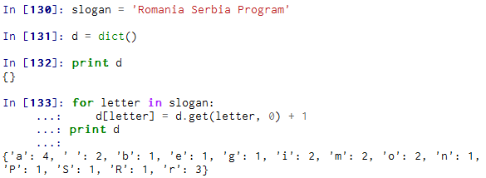
Dictionary as a set of counters (2)
get that takes a key and a default value.
If the key appears in the dictionary, get returns the corresponding value; otherwise it returns the default value
Notes:
Slide 15: Dictionary as a set of counters (2):
Dictionaries have a special method called get that takes a key and a default value. If the key appears in the dictionary, then get will return the corresponding value; otherwise it will return the default value. Now, please take a look at our histogram example, but this time being implemented with get. Because get automatically handles the case where a key is not in a dictionary, we can reduce four lines down to one and also we can eliminate the if statement from the previous implementation.

Slide 16
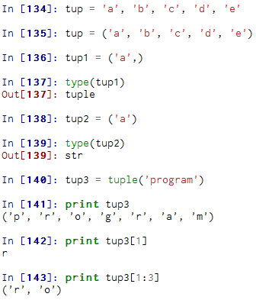
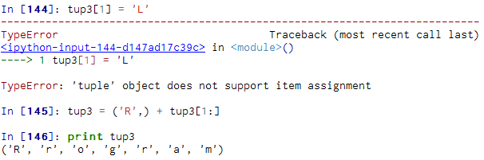
Tuples
Tuples are another kind of sequence that function much like a list - they have elements which are indexed starting at 0
Unlike a list, once you create a tuple, you cannot alter its contents - similar to a string
Notes:
Slide 16: Tuples:
And finally, tuples! A tuple is a sequence of values much like a list. The values stored in a tuple can be any type, and they are indexed by integers. The important difference is that tuples are immutable. Tuples are also comparable and hashable so we can sort lists of them and use tuples as key values in Python dictionaries. (Charles Severance, Python for Informatics: Exploring Information)
Syntactically, a tuple is a comma-separated list of values, as you can see on line 134 of our examples. But there is a common practice among programmers, to enclose tuples in parentheses to help us better identify Python code that contain tuples. If we want to create a tuple with a single element, it is mandatory to include the final comma, otherwise Python will treat that argument as an expression with a string in parentheses that evaluates to a string and not to tuple.
There is another technique to construct a tuple with the built-in function tuple(.) If the argument is a sequence (string, list or tuple), the result of the call to tuple
is a tuple with the elements of the sequence, as you can see on line 141. You can also index an element and apply the slice operator just like in the case of lists. You can’t modify the elements of a tuple, you even get an error for that, but you can replace one tuple with another, as you see on line 145.

Slide 17
Tuples are more efficient
Since Python does not have to build tuple structures to be modifiable, they are simpler and more efficient in terms of memory use and performance than lists
So in our program when we are making "temporary variables" we prefer tuples over lists.
Notes:
Slide 17: Tuples are more efficient:
Since Python does not have to build tuple structures to be modifiable, they are simpler and more efficient in terms of memory use and performance than lists. Therefore in our program when we are making "temporary variables" we prefer tuples over lists.

Slide 18

Comparing tuples (1)
The comparison operators work with tuples and other sequences. If the first item is equal, Python goes on to the next element, and so on, until it finds elements that differ
Notes:
Slide 18: Comparing tuples (1):
The comparison operators work with tuples and other sequences as well. If the first item is equal, then Python will go on to the next element, and so on, until it finds elements that differ.

Slide 19
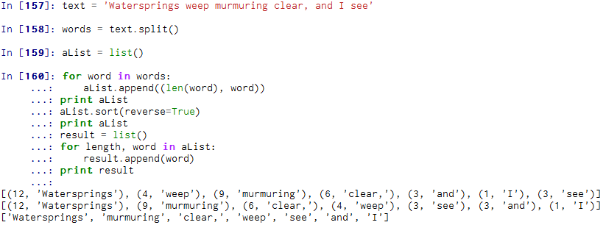
Comparing tuples (2)
sort function: It sorts primarily by first element, but in the case of a tie, it sorts by second element, and so on.
The keyword argument reverse=True tells sort to go in decreasing order
Notes:
Slide 19: Comparing tuples (2):
We can also use the sort function with function. It sorts primarily by first element, but in the case of a tie, it sorts by second element, and so on. For example, suppose you have a list of words and you want to sort them from longest to shortest. So we will use the implementation from the slide. The first loop builds a list of tuples, where each tuple is a word preceded by its length. sort compares the first element, length, first, and only considers the second element to break ties. The keyword argument reverse=True tells sort to go in decreasing order.
The second loop traverses the list of tuples and builds a list of words in descending order of length. So among the five character words, they are sorted in reverse
alphabetical order. (after Charles Severance, Python for Informatics: Exploring Information)
Please note that the intermediary lists are printed in different stages of the program so that you can easily watch the transformation of the list and the final result. So in the beginning in aList we will find the words from the initial text, then for each word we associate a value of its length, we sort it and finally we obtain a list of words arranged from the longest to shortest.

Slide 20
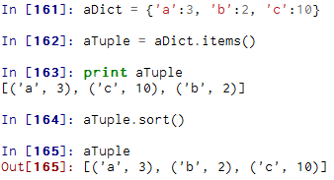
Dictionaries and tuples
The items() method in dictionaries returns a list of (key, value) tuples
Notes:
Slide 20: Dictionaries and tuples:
Dictionaries have a method called items that returns a list of tuples, where each tuple is a key-value pair. In Python 3.0 this behavior is slightly different, so we let it as homework to try this in Python 3.0. Since the list of tuples is after all a list, and as we know tuples are comparable, we can now sort the list of tuples. Converting a dictionary to a list of tuples is a technique to output the contents of a dictionary sorted by key. As you can see the new list, called by us aTuple is sorted in ascending alphabetical order by the key value.

Slide 21
Homework
Rewrite the program that prompts the user for a list of numbers and prints out the maximum and minimum of the numbers at the end when the user enters “done”. Write the program to store the numbers the user enters in a list and use the max() and min() functions to compute the maximum and minimum numbers after the loop completes.
Write a program to read through a mail log, and build a histogram using a dictionary to count how many messages have come from each email address and print the dictionary.
Write a program that reads a file and prints the letters in decreasing order of frequency. Your program should convert all the input to lower case and only count the letters a-z. Your program should not count spaces, digits, punctuation or anything other than the letters a-z.
Notes:
Slide 21: Homework: As homework, here are some exercises that you are invited to solve, based on your knowledge you have gained so far and especially during this course on lists, dictionaries and tuples. Also, try solving the examples presented in the course by working them out in Canopy.

Slide 22

Python resources
Charles Severance:
Python for Informatics: Exploring Information
Kenneth Alfred Lambert
Fundamentals of Python: From First Programs Through Data Structures
Web resources:
http://learnpythonthehardway.org/book/
https://docs.python.org
Notes:
Slide 22: Python resources:
And this is the end of our course. Thank you very much for watching these series. Don’t forget that as textbooks for this course we used mainly Python for Informatics: Exploring Information of Professor Charles Severance which is distributed under a Creative Commons Attribution License; therefore many materials are offered under this license, like books, files, slides, videos and so on. Another textbook is Fundamentals of Python: From First Programs Through Data Structures of professor Kenneth Alfred Lambert. But also on the web you can find a large spectrum of resources available for learning Python. From here you can continue learning Python by deeply studying the above mentioned resources and trying out your own code, projects and so on. Good luck and thank you very much for watching this course! ☺

